Slide 1
UNIT 1
GENERAL ISSUES AND OVERVIEW OF AI
1

Slide 2
What is AI ?
Artificial Intelligence is the science and engineering of making intelligent machines.
Artificial Intelligence is the study of how to make computers do things which, at the moment, people do better.
Artificial Intelligence is the branch of computer science that is concerned with the automation of intelligent behavior.
Artificial Intelligence is the study and design of intelligent agents, where an intelligent agent is a system that perceives its environment and takes actions that maximize its chance of success.
2

Slide 3
What is AI ?
Artificial Intelligence
is concerned with the design of
intelligence in an artificial device.
The term was coined by McCarthy in 1956.
There are two ideas in the definition.
Intelligence
Artificial
The term artificial is easy to understand. But it’s very difficult
to define intelligence.
3

Slide 4
What is Intelligence?
Intelligence is what we use when we don’t know what to do.
Intelligence relates to tasks involving higher mental processes.
Examples: Creativity, Solving problems, Pattern recognition, Classification, Learning, Induction, Deduction, Building analogies, Optimization, Language processing, Knowledge and many more.
4

Slide 5
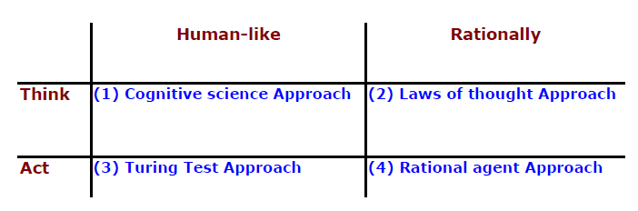
Goals of AI
The definition of AI gives four possible goals to pursue:
Systems that think like humans
Systems that think rationally
Systems that act like humans
Systems that act rationally
Traditionally, all four goals have been followed and the approaches were:
Most of AI works falls into category 2 and 4.
5

Slide 6
Systems that think like humans
Most of the time it is a black box where we are not clear about our thought process.
One has to know functioning of brain and its mechanism for possessing information.
It is an area of cognitive science.
The stimuli are converted into mental representation.
Cognitive processes manipulate representation to build new representations that are used to generate actions.
Neural network is a computing model for processing information similar to brain.
6

Slide 7
Systems that act like humans
The overall behaviour of the system should be human like.
It could be achieved by observation.
7

Slide 8
Systems that think rationally
Such systems rely on logic rather than human to measure correctness.
For thinking rationally or logically, logic formulas and theories are used for synthesizing outcomes.
For example,
– given John is a human and all humans are mortal then one can conclude logically that John is mortal
Not all intelligent behavior are mediated by logical deliberation.
8

Slide 9
Systems that act rationally
Rational behavior means doing right thing.
Goal is to develop systems that are rational and sufficient.
9

Slide 10
General AI Goals
Replicate human intelligence
Solve knowledge intensive tasks
Make an intelligent connection between perception and action
Enhance human-human, human-computer and computer to computer interaction/communication
10

Slide 11
AI Goal
Engineering based AI Goal
Develop concepts, theory and practice of building intelligent machines
Emphasis is on system building
Science based AI Goal
Develop concepts, mechanisms and vocabulary to understand biological intelligent behavior.
Emphasis is on understanding intelligent behavior.
11

Slide 12
Introduction
Foundation of AI was laid with Boolean theory by a mathematician, Boole & other researchers
Since the invention of computer in 1943, AI has been of interest to the researchers
They always aimed to make machines more intelligent than humans
AI has grown substantially for last six decades starting from simple to intelligent programs

Slide 13
AI comprises of a numerous subfields ranging from general purpose areas to specific tasks
General purpose areas: perception, logical reasoning, et.
Specific tasks: game playing, theorem proving, diagnosing diseases, etc.
Scientists of other fields use AI to systematize and automate the intellectual tasks
AI is engaged in two different significant fields:
Science of human intelligence
Engineering discipline

Slide 14
Applications area of AI
Perception
Machine vision
Speech understanding
Touch ( tactile or haptic) sensation
Robotics
Natural Language Processing
Natural Language Understanding
Speech Understanding
Language Generation
Machine Translation
Planning
Expert Systems
Machine Learning
Theorem Proving
Symbolic Mathematics
•
Game Playing
14

Slide 15
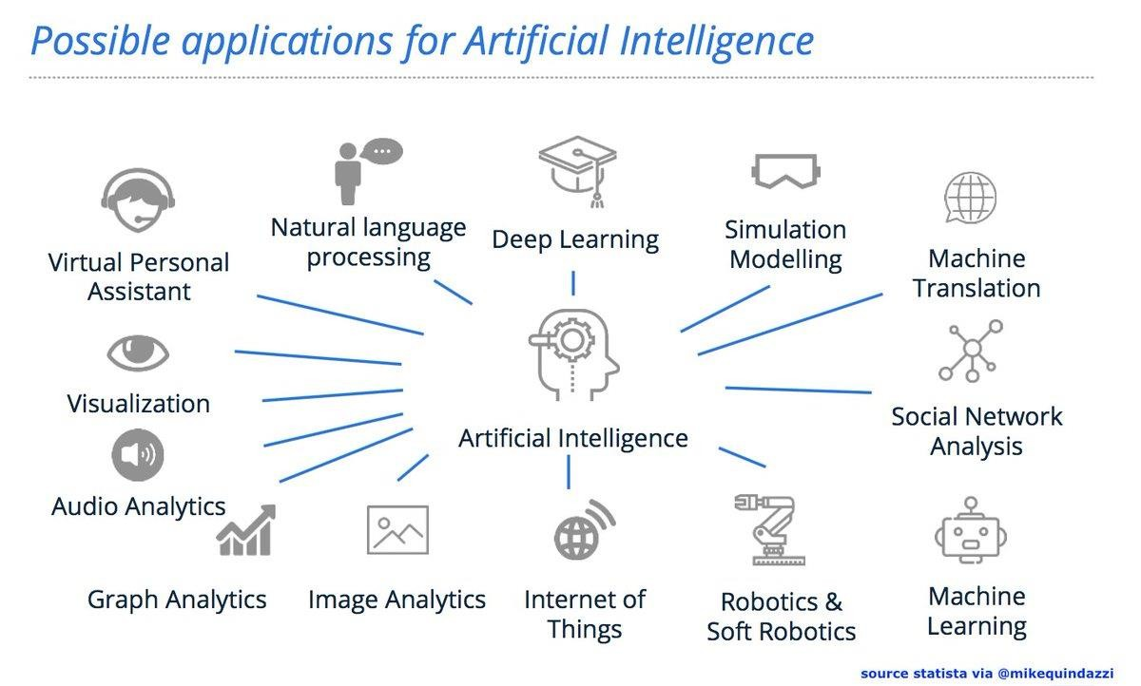

Slide 16
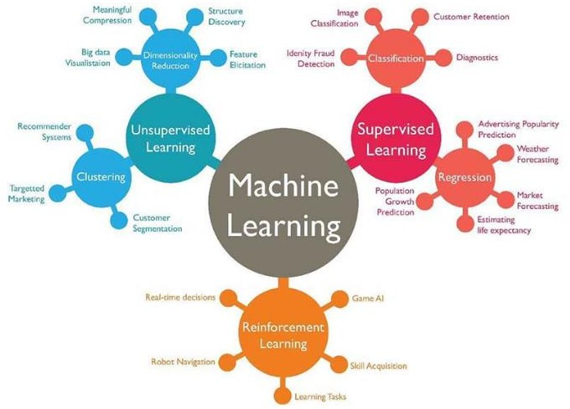

Slide 17
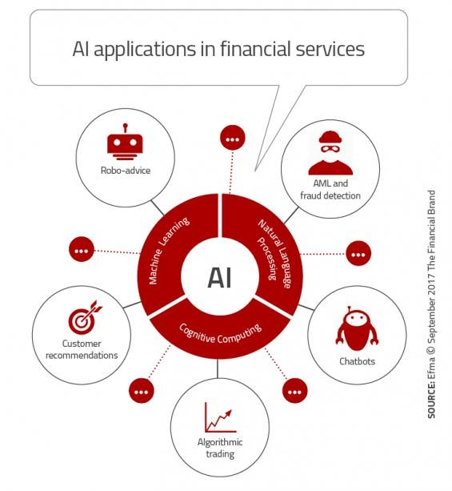

Slide 18


Slide 19
History
In 400 B.C, philosophers said that, mind operates on knowledge encoded in some internal language
Psychologists strengthened the idea that, living creatures are information processing machines
Mathematicians provided tools to manipulate certain or uncertain logical statements of certainty as well as probabilistic statements

Slide 20
John McCarthy organized a conference on machine intelligence in 1956, since then the field is known as AI
In 1957, a program named GPS (General Problem Solver) was developed and tested on problems requiring common sense
John McCarthy announced his new development i.e.,
LISP (LISt Processing language) in 1958
MarvinMinsky of MIT demonstrated that computer programs could solve spatial and logic problems
1960, another program named as STUDENT was developed to solve algebraic problems

Slide 21
L.Zadeh has developed Fuzzy set and logic to make decisions under uncertain conditions.
Terry Winograd at MIT, AI Laboratory developed SHRDLU, is a program which carries a simple dialogue with a user in English. This is written in MACLISP.
Minsky also developed Frame Theory around 1970 used for storing structured programs to be used by AI programs.
R.Kowalski developed PROLOG language around 1970. (Expert Systems are also developed in the same year)

Slide 22
L.Zadeh has developed Fuzzy set and logic to make decisions under uncertain conditions
Terry Winograd at MIT, developed SHRDLU, a program which carries a simple dialogue with a user in English. This is written in MACLISP
Minsky also developed Frame Theory around 1970 used for storing structured programs to be used by AI programs
R.Kowalski developed PROLOG language around 1970. (Expert Systems are also developed in the same year)

Slide 23
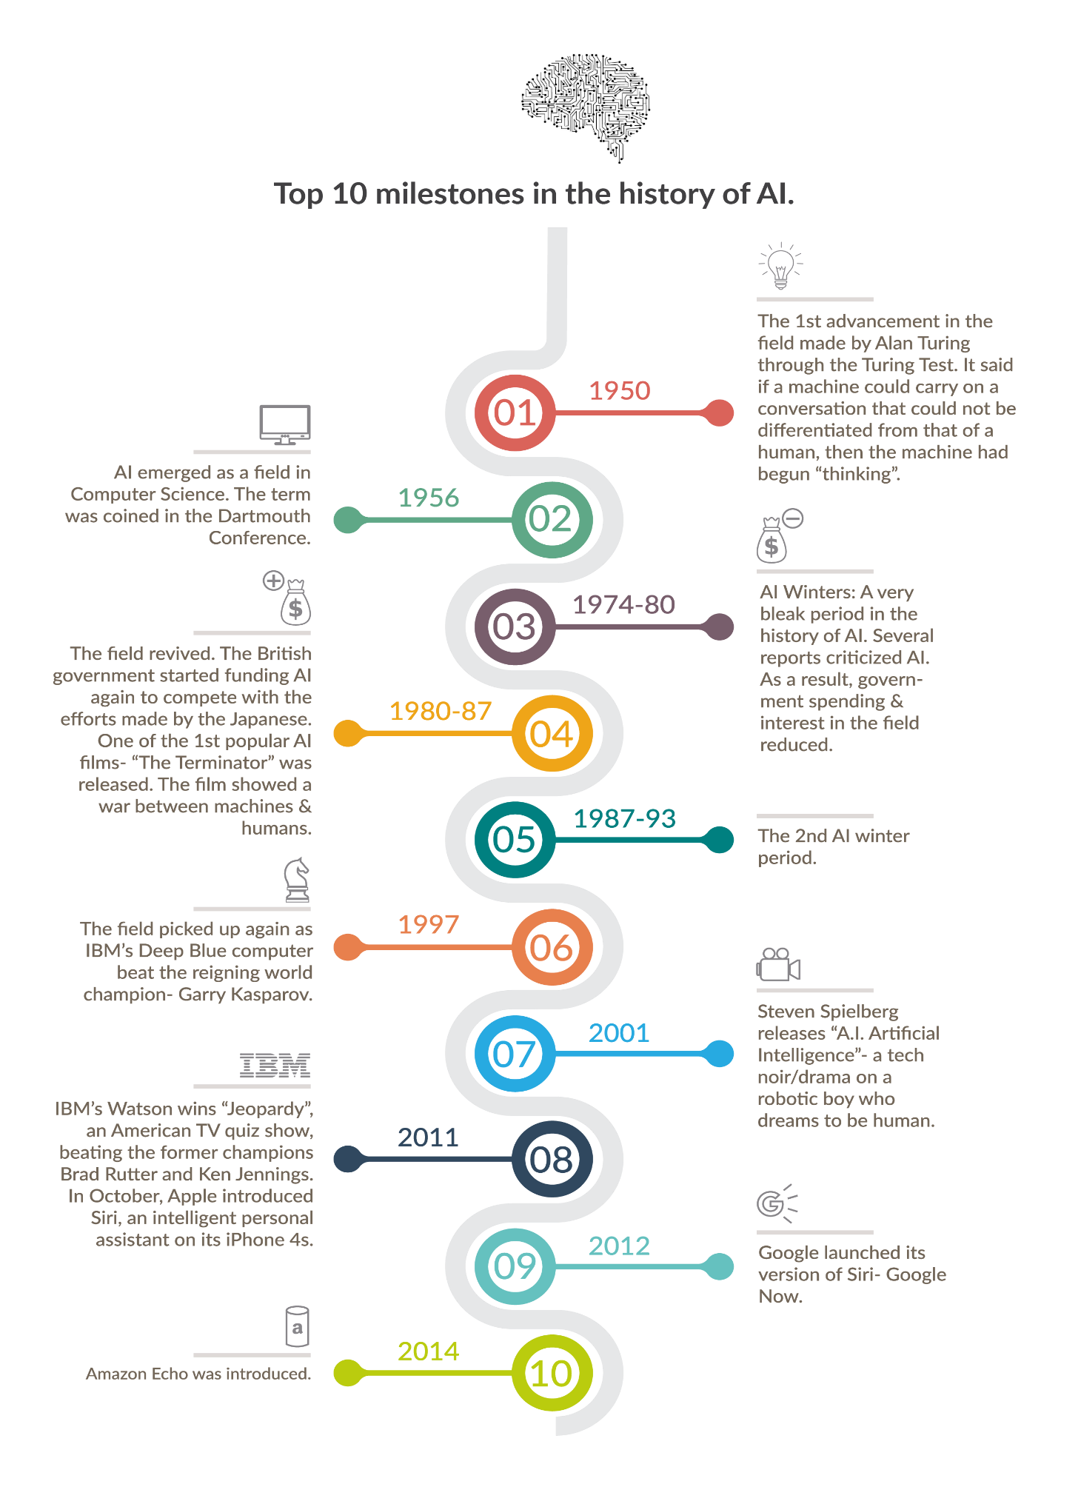

Slide 24
Major components of an AI system
Heuristic Search
Knwoledge
Representation
AI Program
AI
Programming languages and tools
AI Hardware
24

Slide 25
Components of AI Program
AI Program should have:
Knowledge base and navigational capacity which contains control strategy and
Inference mechanism
Knowledge base:
AI programs should be learning in nature and update its knowledge accordingly
it consists of facts and rules and characteristics like voluminous, incomplete, imprecise, dynamic and keep changing

Slide 26
Control strategy:
It determines which rule to be applied
For this heuristics, or related thumb rules are used
Inference mechanism:
It requires search through knowledge base
Derives new knowledge using existing knowledge with the help of inference rules

Slide 27
Foundations of AI
Commonly used AI techniques are rule-based, fuzzy logic, neural networks, decision theory, statistics, probability theory, genetic algorithms, etc.
Since AI is interdisciplinary in general, foundations of AI are
Mathematics
Neuroscience
Control theory
Linguistics

Slide 28
Applications
Business: financial strategies, advising
Engineering: check design, offer suggestions to create new products, expert systems
Manufacturing: assembly, inspection, maintenance
Medicine: monitoring, diagnosing, prescribing
Education: teaching
Fraud detection
Object identification
Space shuttle scheduling
Information retrieval

Slide 29
Current trends in AI
Current trends in AI are basically towards the development of technologies which have origin with biological or behavioral phenomena related to human or animals such as evolutionary computation
Evolutionary computation uses iterative progress, such as growth or development
It is inspired by biological mechanism or evolution

Slide 30
Evolutionary paths of AI and simulation started to converge in cognitive psychology
Simulation has been developed to study and understand complex time varying behaviours exhibited by real physical systems
ANN has been developed based on functioning of human brain to predict features based on previous details
Evolutionary techniques mostly involve meta- heuristic optimization algorithms such as evolutionary algorithms and swarm intelligenc

Slide 31
Genetic algorithms based on Darwin theory of evolution were developed mainly by emulating the nature and behaviour of biological chromosome
Swarm intelligence is based on the collective behaviour of decentralized, self-organized systems
Ants, bees and termites etc. solve complex problems by mutual cooperation
This emergent behaviour of self-organization by a group of social insects is known as swarm intelligence

Slide 32
In computational sense, the set of mobile agents which are liable to communicate directly or indirectly with each other and which collectively carry out a distributed problem solving is known as swarm intelligence
Expert systems continues to remain an attractive field for its practical utility in all walks of real life
Emergence of agent technology as a subfield of AI, is a significant paradigm shift for s/w development

Slide 33
Information, Knowledge, Intelligence
Information is a message that contains relevant meaning, implication, or input for decision and/or action. Information comes from both current (communication) and historical (processed data or ‘reconstructed picture’) sources. In essence, the purpose of information is to aid in making decisions and/or solving problems or realizing an opportunity.
Knowledge is the cognition or recognition (know-what), capacity to act (know-how), and understanding (know-why) that resides or is contained within the mind or in the brain. The purpose of knowledge is to better our lives.
Intelligence (also called intellect) is an umbrella term used to describe a property of the mind that encompasses many related abilities, such as the capacities to reason, to plan, to solve problems, to think abstractly, to comprehend ideas, to
_{use language, and to}Pr_{l}e_{e}pa_{a}red_{r}b_{n}y .: -Agniwesh Mishra, RCET,
Bhilai
36

Slide 34
Human intelligence Vs. Artificial intelligence
Human intelligence | Artificial intelligence
Human intelligence revolves around adapting to the environment using a combination of several cognitive processes. | The field of Artificial intelligence focuses on designing machines that can mimic human behavior.
Human Intelligence is organically based, | Artificial Intelligence is silicon based.
Human intelligence is separated through the five senses. | Computer intelligence is separated into binary code
Human memory...Five access points | Artificial intelligence...Just one access point....
The human mind on the other hand works by asociation, which is not always logical in a technical sense. | Artificially Intelligence works along pre- set formulas and ways, it is rather straight forward.
Prepared by : -Agniw | esh Mishra, RCET, ₃₇
Bhilai

Slide 35
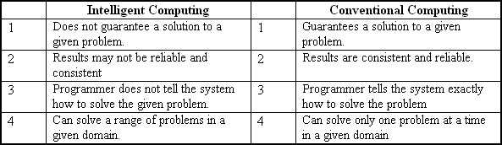
Intelligent Computing Vs. conventional computing
35

Slide 36
The AI Problem
36

Slide 37
The AI Problem
Much of the early work in the field focused on formal tasks, such as game playing and theorem proving.
Another early foray into AI focused on the sort of problem solving that we do every day called as mundane tasks, such as commonsense reasoning.
The problem area where AI is now flourishing most as a practical discipline are primarily the domains that require only specialized expertise without the assistance of commonsense knowledge, called as expert systems.
37

Slide 38
Formal Tasks
Games
Chess
Backgammon
Checkers-Go
Mathematics
Geometry
Logic
Internal calculus
Proving properties of programs
38

Slide 39
Mundane Tasks
Perception
Vision
Speech
Natural language
Understanding
Generation
Translation
Commonsense reasoning
Robot control
39

Slide 40
Expert Tasks
Engineering
Design
Fault finding
Manufacturing planning
Scientific analysis
Medical diagnosis
Financial analysis
40

Slide 41
What is an AI technique
41

Slide 42
What is an AI technique
AI technique is a method that exploits knowledge which should be represented in such a way that –
i. The knowledge captures generalization or we can say that situations that share important properties and grouped together rather than to represent separately each individual situation.
ii. It can be understood by people who provide it. In many AI domains most of the knowledge, a programs has, must ultimately be provided by people in terms they understand.
It can easily be modified to correct errors and to reflect changes in the world and in our world view.
It can be used in a great many situations even if it is not totally
accurate or complete.
It can be used to help overcome its own sheer bulk by to narrow the range of possibilities that must usually be considered.
iii.
42

Slide 43
Examples of AI problems
Tic-Tac toe
Water jug problem
8-puzzle problem
8-queen problem
Chess problem
Missionaries and cannibals problem
Tower of Hanoi problem
Traveling salesman problem
Magic square
Language understanding problems
Monkey and Banana Problem
Crypt arithmatic puzzle
Block World problem
43

Slide 44
Problem solving /Problem representation
44

Slide 45
Problem solving
Problem solving is a process of generating solutions from observed data.
Key element of problem solving
State: A state is a representation of problem at a given moment.
State space: Contains all the possible states for a given problem.
Operators: the available actions performed is called operators.
Initial state: position from which process may start.
Goal state: solution to the problem.
the problem-solving
45

Slide 46
General Problem solving
To build a system, to solve a praticular problem, there are four things:
Define the problem precisely (apply the State Space representation).
Analyze the problem.
Isolate and represent the task knowledge that is necessary to solve the problem.
Choose the best problem solving technique(s) and apply it to the particular problem.
46

Slide 47
Problem Characteristics
To choose an appropriate method for a particular problem:
Is the problem decomposable?
Can solution steps be ignored or undone?
Is the universe predictable?
Is a good solution absolute or relative?
Is the solution a state or a path?
What is the role of knowledge?
Does the task require human-interaction?
47

Slide 48
1. Is the problem decomposable?
Can the problem be broken down to smaller problems to be solved independently?
Decomposable problem can be solved easily.
48

Slide 49
1. Is the problem decomposable?
∫(x² + 3x + sin²x.cos²x)dx
∫3xdx ∫sin²x.cos²xdx
∫(1 − cos²x)cos²xdx
∫cos²xdx −∫cos⁴xdx
∫x²dx
49

Slide 50
2. Can solution steps be ignored or
undone?
Theorem Proving
A lemma that has been proved can be ignored for next steps.
Ignorable!
50

Slide 51
2. Can solution steps be ignored or
undone?
The 8-Puzzle
2 | 8 | 3
1 | 6 | 4
7 |  | 5
1 | 2 | 3
8 |  | 4
7 | 6 | 5
Moves can be undone and backtracked.
Recoverable!
51

Slide 52
2. Can solution steps be ignored or
undone?
Playing Chess
Moves cannot be retracted.
Irrecoverable!
52

Slide 53
2. Can solution steps be ignored or
Ignorable problems can be solved using a simple control structure that never backtracks.
Recoverable problems can be solved using backtracking.
Irrecoverable problems can be solved by recoverable style methods via planning.
undone?
53

Slide 54
3. Is the universe predictable?
The 8-Puzzle
Every time we make a move, we know exactly what will
happen.
Certain outcome!
54

Slide 55
3. Is the universe predictable?
Playing Bridge
We cannot know exactly where all the cards are or what
the other players will do on their turns.
Uncertain outcome!
55

Slide 56
3. Is the universe predictable?
For certain-outcome problems, planning can used to generate a sequence of operators that is guaranteed to lead to a solution.
For uncertain-outcome problems, a sequence of generated operators can only have a good probability of leading to a solution.
Plan revision is made as the plan is carried out and the necessary feedback is provided.
56

Slide 57
4. Is a good solution absolute or relative?
Marcus was a man.
Marcus was a Pompeian.
Marcus was born in 40 A.D.
All men are mortal.
All Pompeians died when the volcano erupted in 79 A.D.
No mortal lives longer than 150 years.
It is now 2004 A.D.
57

Slide 58
4. Is a good solution absolute or relative?
Marcus was a man.
Marcus was a Pompeian.
Marcus was born in 40 A.D.
All men are mortal.
All Pompeians died when the volcano erupted in 79 A.D.
No mortal lives longer than 150 years.
It is now 2004 A.D.
Is Marcus alive?
58

Slide 59
4. Is a good solution absolute or
relative?
Marcus was a man.
Marcus was a Pompeian.
Marcus was born in 40 A.D.
All men are mortal.
All Pompeians died when the volcano erupted in 79 A.D.
No mortal lives longer than 150 years.
It is now 2004 A.D.
Is Marcus alive?
Different reasoning paths lead to the answer. It does not matter which path we follow.
59

Slide 60
4. Is a good solution absolute or
relative?
The Travelling Salesman Problem
We have to try all paths to find the shortest one.
60

Slide 61
4. Is a good solution absolute or
relative?
Any-path problems can be solved using heuristics that suggest good paths to explore.
For best-path problems, much more exhaustive search will be performed.
61

Slide 62
5. Is the solution a state or a path?
Finding a consistent intepretation
“The bank president ate a dish of pasta salad with
the fork”.
“bank” refers to a financial situation or to a side of a river?
“dish” or “pasta salad” was eaten?
Does “pasta salad” contain pasta, as “dog food” does not contain “dog”?
Which part of the sentence does “with the fork” modify? What if “with vegetables” is there?
No record of the processing is necessary.
62

Slide 63
5. Is the solution a state or a path?
The Water Jug Problem
The path that leads to the goal must be reported.
63

Slide 64
5. Is the solution a state or a path?
A path-solution problem can be reformulated as a state- solution problem by describing a state as a partial path to a solution.
The question is whether that is natural or not.
64

Slide 65
6. What is the role of knowledge
Playing Chess
Knowledge is important only to constrain the search for a
solution.
Reading Newspaper
Knowledge is required even to be able to recognize a solution.
65

Slide 66
7. Does the task require human- interaction?
Solitary problem, in which there is no intermediate communication and no demand for an explanation of the reasoning process.
Conversational problem, in which intermediate communication is to provide either additional assistance to the computer or additional information to the user.
66

Slide 67
State space representation
Before a solution can be found, the prime condition is that the problem must be very precisely defined. By defining it properly, one converts the abstract problem into real workable states that are really understood.
A set of all possible states for a given problem is known as the state space of the problem.State space representations are highly beneficial in AI because they provide all possible states, operations and goals.
If the entire state space representations for a problem is given, it is possible to trace the path from the initial state to the goal state and identify the sequence of operators necessary for doing it.
The major deficiency of this method is that it is not possible to visualize all states for a given problem. Moreover, the resources of the computer system are limited to handle huge
state-space representation.
Prepared by : -Agniwesh Mishra, RCET,
67
Bhilai

Slide 68
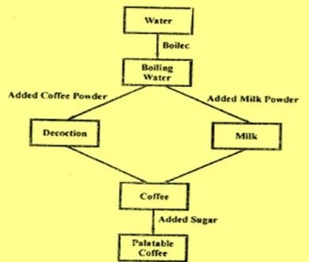
State space representation of coffee making
68

Slide 69
8- puzzle problem
In the 8-puzzle problem we have a 3×3 square board and 8 numbered tiles. The board has one blank position.
Tiles can be slid to adjacent blank positions. We can alternatively and equivalently look upon this as the movement of the blank position up, down, left or right.
The objective of this puzzle is to move the tiles starting from an initial position and arrive at a given goal configuration.
69

Slide 70
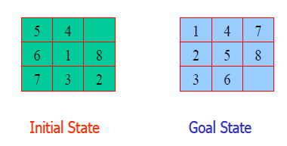
Initial and goal state
The start state
is some random
(almost)
configuration of the tiles The goal state is as shown Operators are
Move empty space up Move empty space down Move empty space right Move empty space left
70

Slide 71
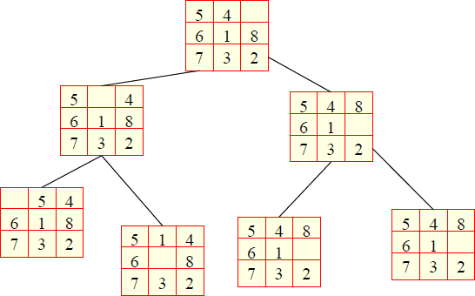
State space of the 8 puzzle problem
71

Slide 72
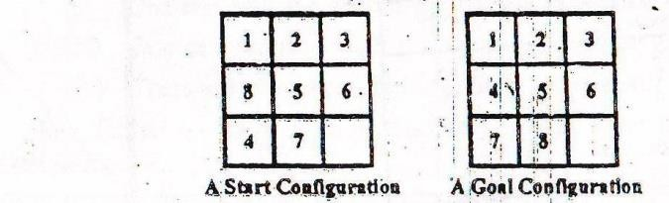
8- puzzle problem
72

Slide 73
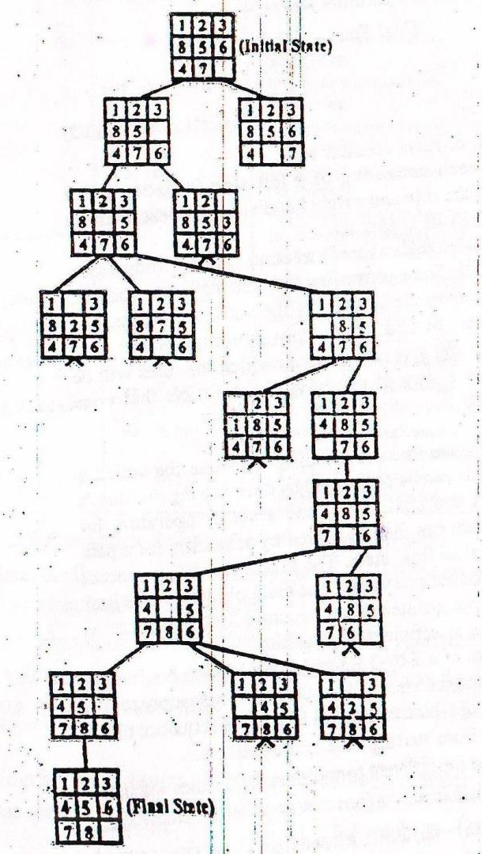
Solution
78

Slide 74
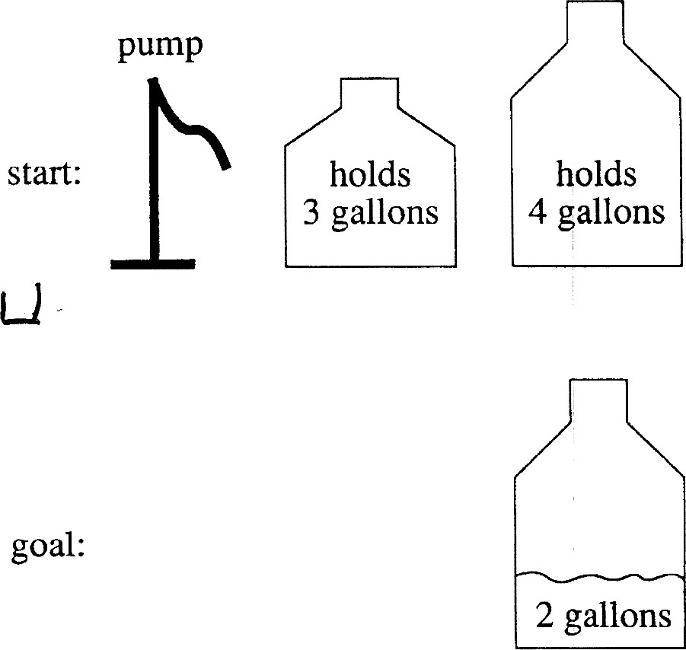
A Water Jug Problem
You gallon
have a 4-
and a 3-
gallon water jug
You have a pump with an unlimited amount of water
You need to get
exactly 2 gallons in 4-gallon jug
Prepared by : -Agniwesh Mishra, RCET, Bhilai
79

Slide 75
Puzzle-solving as Search
State representation: (x, y)
x: Contents of four gallon
y: Contents of three gallon
Start state: (0, 0)
Goal state (2, n)
Operators
Fill 3-gallon from pump, fill 4-gallon from pump
Fill 3-gallon from 4-gallon , fill 4-gallon from 3-gallon
Empty 3-gallon into 4-gallon, empty 4-gallon into 3- gallon
Dump 3-gallon down drain, dump 4-gallon down drain
75

Slide 76
State Space Search: Water Jug
Problem...
1. (x, y)
if x < 4
2. (x, y)
if y < 3
3. (x, y)
if x > 0
4. (x, y)
if y > 0
5. (x, y)
if x > 0
6. (x, y)
if y > 0
→ (4, y) if x is less than 4, fill the 4 gallon jug
→ (x, 3) fill the 3-gallon jug
→ (x − d, y) pour some water out of the 4 gallon jug
→ (x, y − d) pour some water out of the 3 gallon jug
→ (0, y) empty the 4-gallon jug on the ground
→ (x, 0) empty the 3-gallon jug on the ground
76

Slide 77
Water Jug Problem...
7. (x, y) → (4, y − (4 − x)) if x + y ≥ 4, y > 0
8. (x, y) → (x − (3 − y), 3)
if x + y ≥ 3, x > 0
9. (x, y) → (x + y, 0) if x + y ≤ 4, y > 0
10. (x, y) → (0, x + y) if x + y ≤ 3, x > 0
11. (0, 2) → (2, 0)
12. (2, y) → (0, y)
pour water from the 3- gallon jug into the 4- gallon jug until the 4-gallon jug is full
pour water from the 4- gallon jug into the 3-
gallon jug until the 3-gallon jug is full
pour all the water from the 3-gallon jug into the 4-gallon jug
pour all the water from the 4-gallon jug into the 3-gallon jug
pour the 2 gallons from the 3-gallon jug into the 4-gallon jug
empty the 2 gallons in the 4 gallon jug on the ground
77

Slide 78
State Space Search: Water Jug
Problem...
Current state = (0, 0)
Loop until reaching the goal state (2, 0)
Apply a rule whose left side matches the current state
Set the new current state to be the resulting state
Gallons in the 4- Gallon Jug | Gallons in the 3- Gallon Jug | Rule Applied
0 | 0 | 2
0 | 3 | 9
3 | 0 | 2
3 | 3 | 7
4 | 2 | 5
0 | 2 | 9
2 Prep | 0 ared by : -Agniwesh Mishra, RCE | T,
Bhilai
78

Slide 79
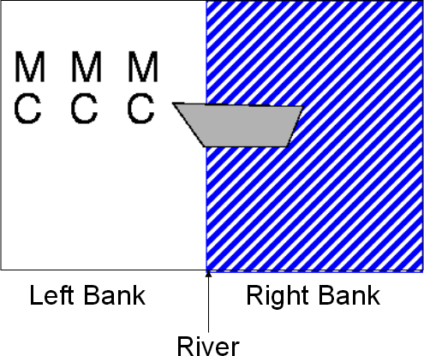
Missionaries and cannibals
The missionaries and cannibals wish to cross a river
They have a boat that can hold two people
It is unsafe to have cannibals
outnumber missionaries
79

Slide 80
Missionaries and cannibals
_{M} M
C
M
M
_{M} C _{C}
M
C
C _{C}
Initial state
Goal state
80

Slide 81
States
A state can be represented by the number of missionaries and cannibals on each side of the river
State(#m, #c, riverbank)
#m #c
→ no. of missionaries
→ no. of cannibals
Bankofriver→ indicates whether the boat in the left bank or
right bank 0→ left bank, 1→right bank
Initial state (3,3,0)
Goal state: (0,0,0)
81

Slide 82
Operations
An operation takes us from one state to another
Here are five possible operations:
boat takes 1 missionary across river (1m)
boat takes 1 cannibal across river (1c)
boat takes 2 missionaries across river (2m)
boat takes 2 cannibals across river (2c)
boat takes 1 missionary and 1 cannibal across river (1m1c)
82

Slide 83
The state space
3m, 2c
etc.
1c
etc.
2c
3m, 1c
3m, 3c, boat
1m
2m, 3c
2m
3m, 2c, boat
etc.
1m, 3c
1m1c
1m
2m, 2c
1c
2m, 3c, boat
etc.
1m1c
83

Slide 84
Solution
1. (3, 3,0) → (0,0,1) Initial state
(3, 1,0) → (0,2,1) two cannibal will go
(3,2,0) → (0,1,1) one cannibal will return
(3,0,0) →(0,3,1) two cannibal will go
(3,1,0) →(0,2,1) one cannibal will return
(1,1,0) →(2,2,1) two Missionaries will go
(2,2,0) →(1,1,1) one cannibal and one Missionaries will return
(0,2,0) →(3,1,1) two Missionaries will go
(0,3,0) → (3,0,1) one cannibal will return
(0,1,0) →(3,2,1) two cannibal will go
(0,2,0) → (3,1,1) one cannibal will return
(0,0,0) →(3,3,1) two cannibal will go
84

Slide 85
Farmer river crossing Problem
A farmer with his wolf, goat and cabbage come to the edge of a river they all want to cross the river. There is a boat at the rivers edge, but only the farmer can row, the boat can carry two things at a time. if the wolf is ever left alone with the goat, the wolf will eat the goat, similar, if the goat is left alone with the cabbage, the goat will eat the cabbage.
85

Slide 86
Solution
A set of all possible states for a problem is known as the state space of the problem. There are 16 sub-states of the man , wolf, goat and cabbage.
Some of the 16 states such as GC-MW are fatal and may never be entered by the system.
MWGC-φ → initial state φ –MWGC → goal state
86

Slide 87
Sequence of steps for crossing river
First man crosses the river with goat.
Man comes back.
Man takes either cabbage (or wolf) with him to another side.
Man comes back with goat to first side.
Man takes wolf (or cabbage) with him to another side.
Man comes back.
Man takes goat with him to another side.
87

Slide 88
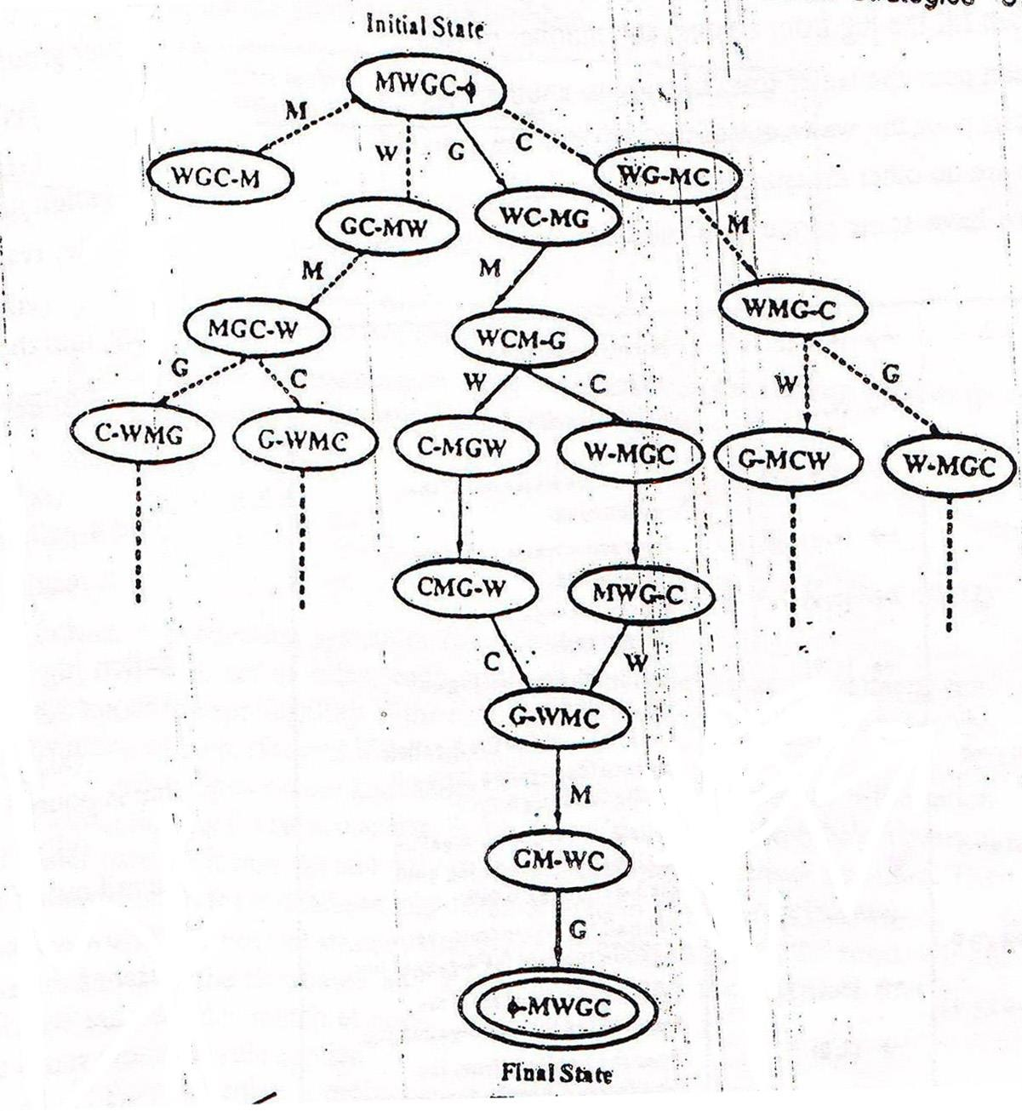
State space representation
88

Slide 89
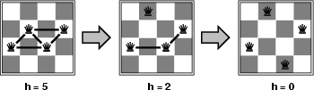
n-queens
States: 4 queens in 4 columns (4⁴ = 256 states)
Actions: move queen in column
Goal test: no attacks
Evaluation: h(n) = number of attacks
Given random initial state, we can solve n-queens for large n
with high probability
Prepared by : -Agniwesh Mishra, RCET,
94
Bhilai

Slide 90
Search and Control strategies
95

Slide 91
Production system
Since search forms the core of many intelligent processes, it is useful to structure AI programs in a way that facilitates describing and performing the search process. Production systems provide such structures.
A production system consist of:-
A set of rules, each consisting of a left side (pattern) that determines the applicability of the rule and a right side describing the operation to be performed.
One or more knowledge/databases that contain whatever information is appropriate for the particular task.
A control strategy that specifies the order in which the rules will be compared to the database and a way of resolving the conflicts that arise when several rules match at once.
96
A rule applier w_{Pre}h_{pa}i_{re}c_{d}h_{by : -}i_{A}s_{gniw}t_{e}h_{sh}e_{Mish}c_{ra}o_{, R}m_{CET,}putational system that implements the control str^{B}a^{hil}tªe^{i} gy and applies the rules.

Slide 92
Classes of Production System
Monotonic production system: the application of a rule never prevents the later application of another rule that could also have been applied at the time the first rule was selected.
Non-monotonic production system: Is one in which this is not true.
Partially commutative production system: the application of a particular sequence of rules transforms state x into state y, then any permutation of those rules that is allowable also transforms state x into state y.
Commutative production system: system that is both monotonic and partially commutative.
92

Slide 93
Control strategies
A control strategy that specifies the order in which the rules will be applied.
Control strategies help us to overcome the abnormal situations, when there are more than one rules or fewer than one rule will have its left sides match the current state.
Requirement for control strategy
A good control strategy causes motion
A good control strategy is systematic
93

Slide 94
Example
(0, 0)
(4, 0)
(0, 3)
(4, 3)
(0, 0)
(1, 3)
(4, 3)
(0, 0)
(3, 0)
94

Slide 95
Search Strategies
Uninformed search (blind search)(Exhaustive search)(Brute force)
Having no information about the number of steps from the current state to the goal.
Informed search (heuristic search)
More efficient than uninformed search.
95

Slide 96
Brute Force or Uninformed Search
Strategies
These are commonly used search procedure which
explore all the alternatives during the search process.
They do not have any domain specific knowledge.
They need the initial state, the goal state and a set of legal operators.
The strategy gives the order in which the search space is searched
The followings are example of uninformed search
Depth First Search (DFS)
Breadth First Search (BFS)
96

Slide 97


Search Strategies: Blind Search
Breadth-first search
Expand all the nodes of
one level first.
Depth-first search
Expand one of the nodes at the deepest level.
97

Slide 98
Depth First Search
The search begins by expanding the initial node, generate all successors of the initial node and test them.
Depth-first search always expands the deepest node in the current frontier of the search tree.
Depth-first search uses a LIFO approach.
103

Slide 99
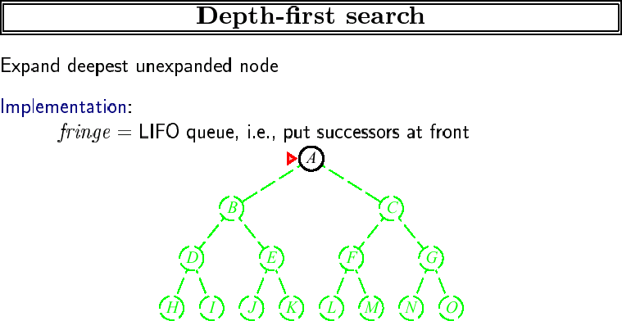
99

Slide 100
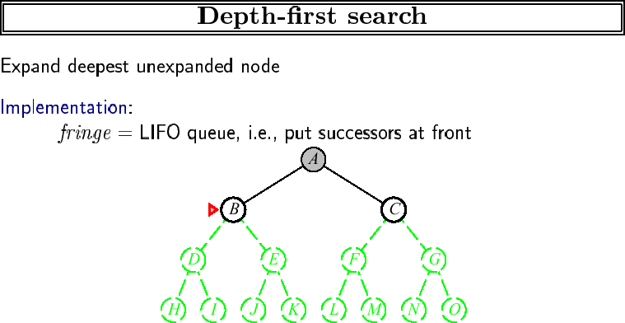
100

Slide 101
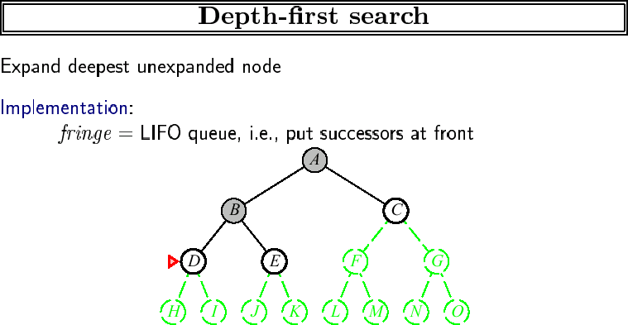
101

Slide 102
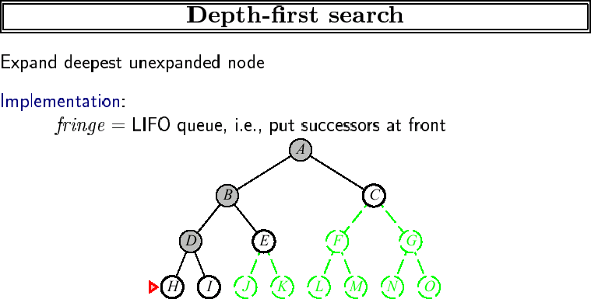
102

Slide 103
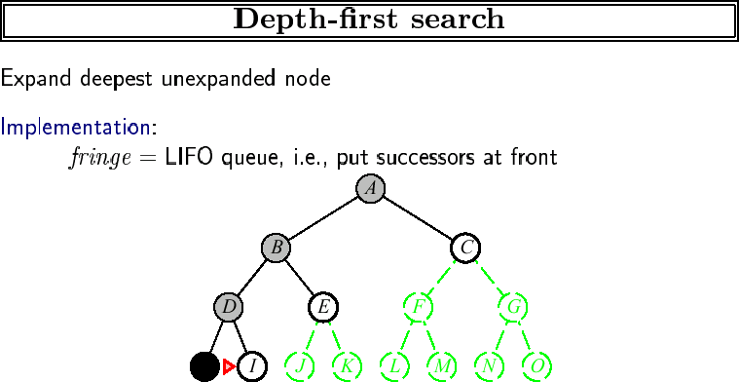
103

Slide 104
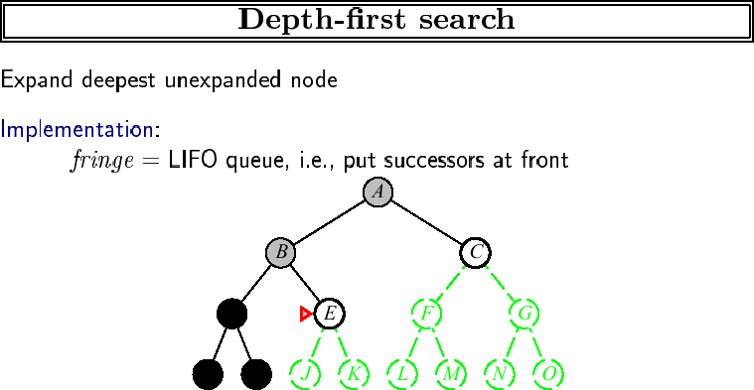
104

Slide 105
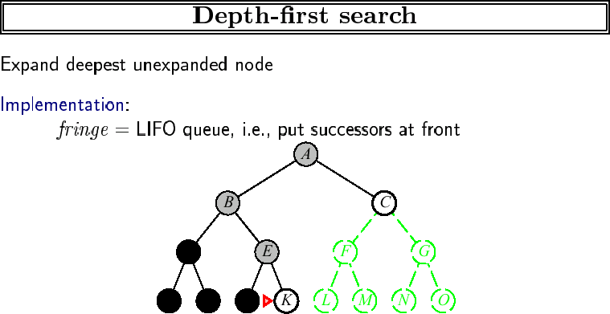
105

Slide 106
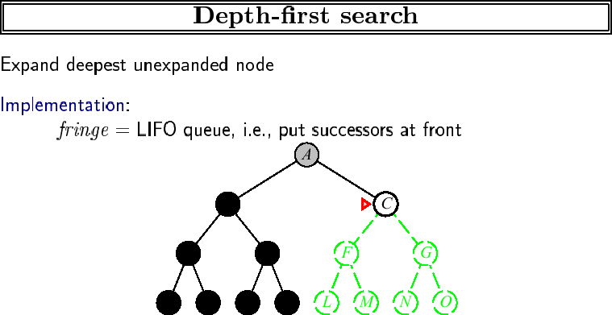
106

Slide 107
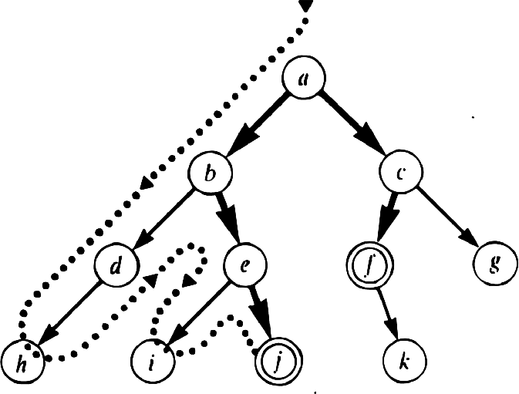
Depth-first search
107

Slide 108
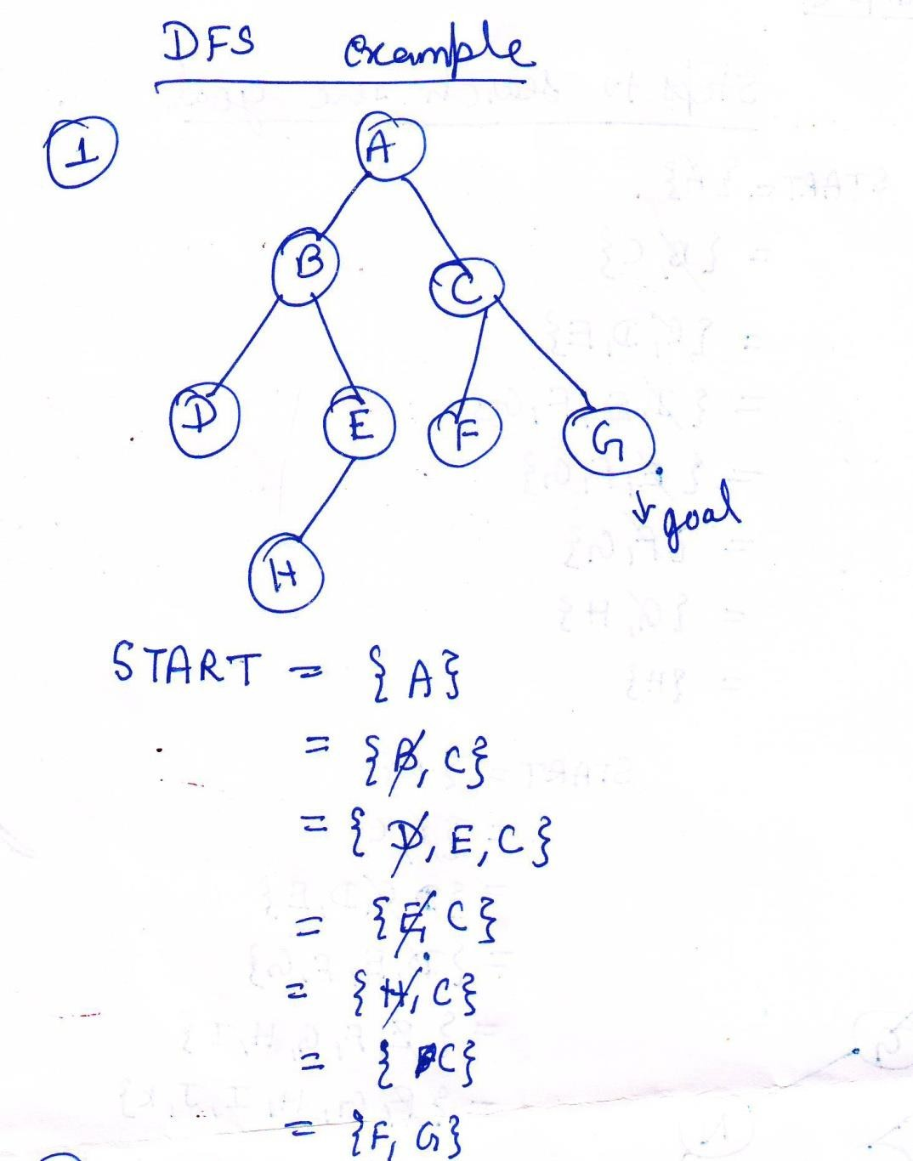
108

Slide 109
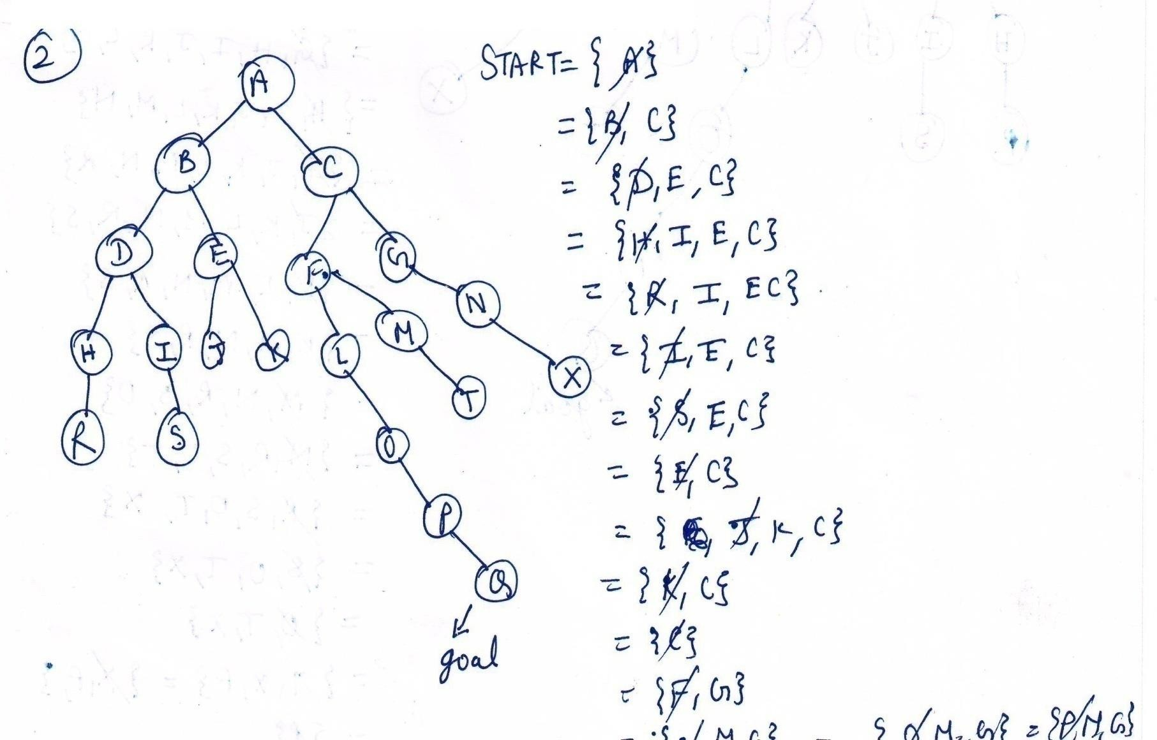
109

Slide 110
Algorithm for Depth First Search
If the initial state is a goal state, quit and return success.
Otherwise, do the following until success or failure is signaled:
Generate a successor, E, of the initial state. If there are no more successors, signal failure.
Call Depth-First Search with E as the initial state.
If success is returned, signal success. Otherwise continue in this loop.
110

Slide 111
Time and space complexity
Time Complexity :
1 + b + b² + b³ +…+……b^{d.}
Hence Time complexity = O ⁽b^{d)}
Where b-> branching factor
d-> Depth of a tree
Space Complexity :
Hence Space complexity = O (d)
111

Slide 112
Advantages of Depth-First Search
It requires less memory since only the nodes of the current path are stored.
By chance, it may find a solution without examining much of the search space at all.
112

Slide 113
Disadvantages of Depth-First Search
Determination of the depth until which the search has to proceed. This depth is called cut-off depth.
If the cut-off depth is smaller, solution may not be found.
If cut-off depth is large, time complexity will be more.
And there is no guarantee to find a minimal solution, if more than one solution exists.
113

Slide 114
Breadth First Search
Searching processes level by level unlike search which goes deep into the tree.
depth
first
An operator is employed to generate all possible children of a node.
114

Slide 115
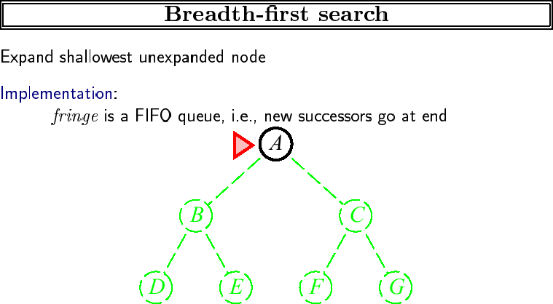
115

Slide 116
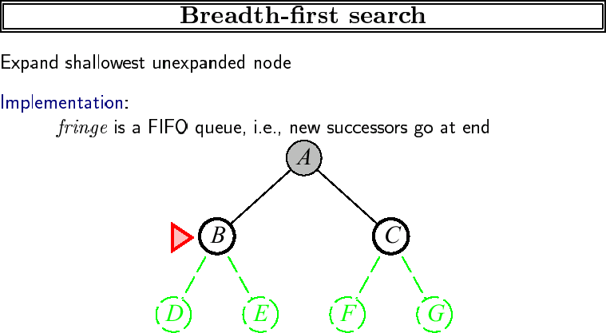
116

Slide 117
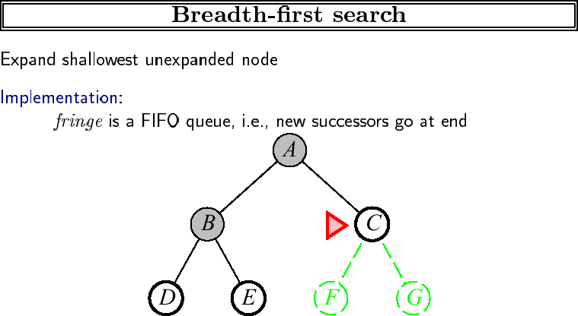
117

Slide 118
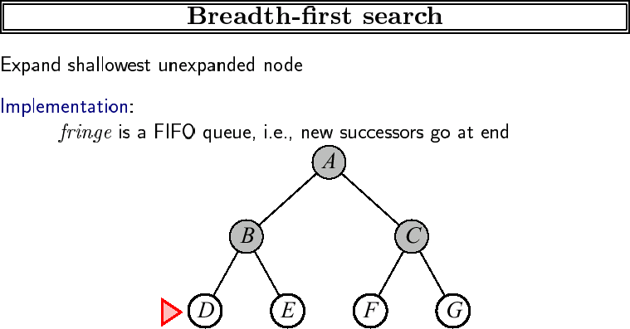
118

Slide 119
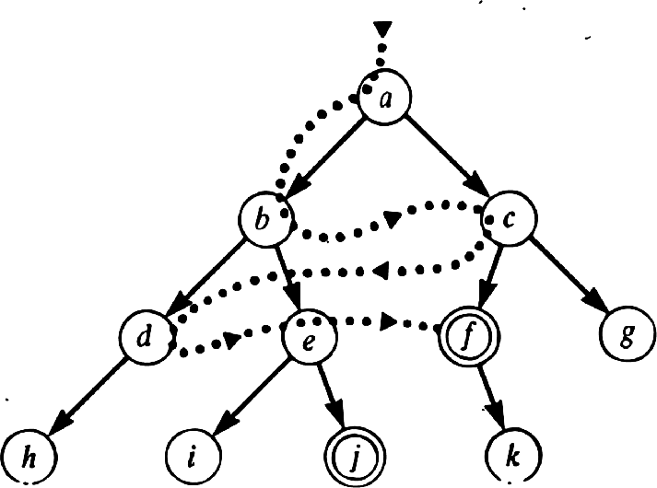
Breadth-first search
Guaranteed to find shortest solution first
best-first finds solution a-c-f
depth-first finds a-b-e-j

Slide 120
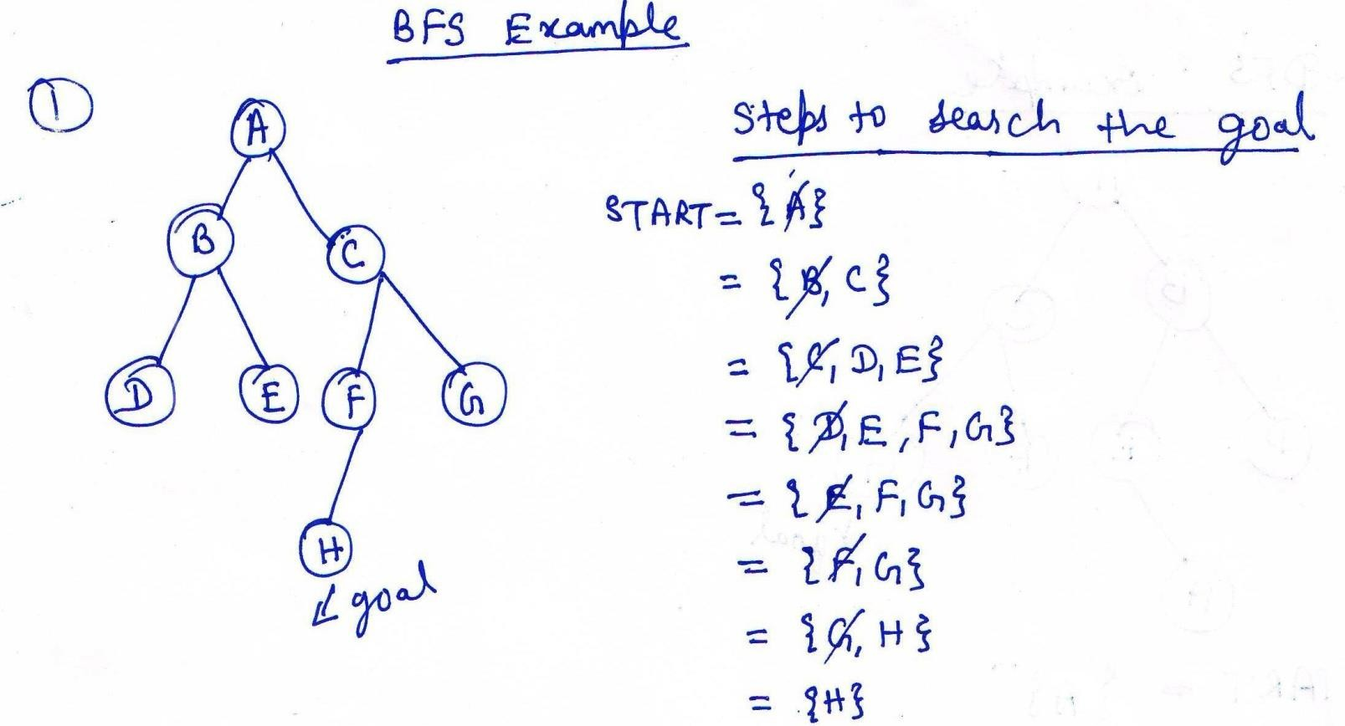

Slide 121
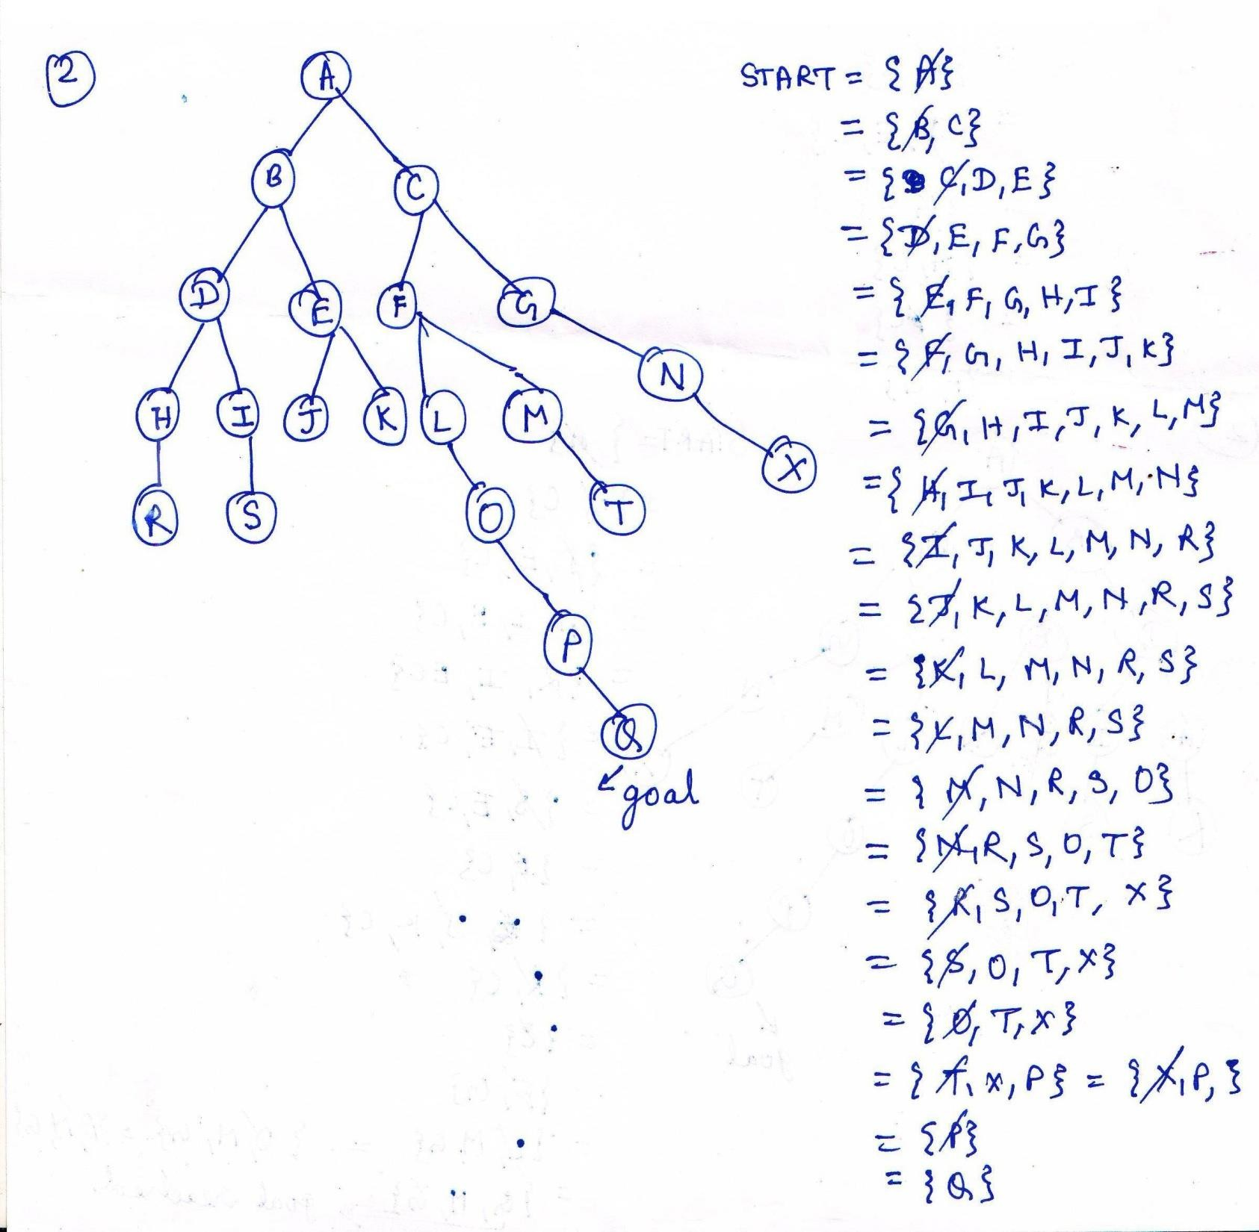

Slide 122
Algorithm of Breadth First Search
Create a variable called Node-LIST and set it to the initial state.
Until a goal state is found or Node-LIST is empty:
Remove the first element from Node-LIST and call it E. if Node-LIST was empty, quit.
For each way that each rule can match the state described
in E do:
Apply the rule to generate a new state,
If the new state is a goal state, quit and return this state.
Otherwise, add the new state to the end of Node-LIST.

Slide 123
Time and space complexity
Time Complexity :
1 + b + b² + b³ +…+……b^{d.}
Hence Time complexity = O (_{b}d)
Space Complexity :
1 + b + b² + b³ +…+……b^{d.}
Hence Space complexity = O (_{b}d)

Slide 124
Advantages of Breadth-First Search
Breadth first search will never get trapped exploring the useless path forever.
If there is a solution, BFS will definitely find it out.
If there is more than one solution then BFS can find the minimal one that requires less number of steps.

Slide 125
Disadvantages of Breadth-First Search
It requires more memory
Searching process remembers all unwanted nodes which is of no practical use for the search.
Prepared by : -Agniwesh Mishra, RCET,
130
Bhilai

Slide 126
DFS Vs BFS
DFS | BFS
It require less memory because only the nodes on the current path are stored. | It require more memory because all the tree that has so far been generated must be stored.
It is one in which by luck solution can be found without examining much of the search space at all. | While in BFS all parts of the tree must be examined to level n before any nodes on level n+1 can be examined.
It does not give optimal solution. | It gives optimal solution.
DFS may find a long path to a solution in one part of the tree, when a shorter path exists in some other, unexplored part of the tree. | BFS guarantees to find a solution if it exists. Furthermore if there are multiple solutions, then a minimal solution will be found.
Time complexity: O(b^{d} ) where b : branching factor, d: depth | Time complexity: O(b^{d} ) where b : branching factor, d: depth
Space complexity: O(d) , d: depth Prepared by : -Agniw | Space complexity: O(b^{d} ) where b : branching factor, d: depth esh Mishra, RCET, ₁₃₁
Bhilai

